Slide 1

DIGITAL ASSIGNMENT 1 | PROGRAMMING FOR DATA SCIENCE (BCSE207L)
Data Preprocessing and Exploratory Analysis for Customer Segmentation Using the Online Retail II Dataset
Suyash Agrawaal
Reg No. 24BDS1167 | Slot G1
Course Faculty: Dr. Meignanamoorthi D
Fall Semester 2026-2027
1

Slide 2
Presentation Overview
01
Dataset Overview
02
Problem Statement & Objectives
Source, scale, and structure of the Online Retail II dataset
Rationale for data cleaning and exploratory analysis
03
Literature Review
04
Data Preprocessing
Five recent papers grounding the methodology
Fourteen R-based cleaning steps, fully executed
05
Exploratory Data Analysis
06
Conclusion
Ten visualizations built on the cleaned dataset
Summary of preprocessing and exploratory analysis outcomes
2

Slide 3
Dataset Overview
The Online Retail II dataset comprises all transactions recorded by a UK-based, non-store online gift retailer over a continuous two-year period. As data drawn from an operating business, it exhibits authentic data-quality issues - missing identifiers, cancellations, and duplicate records - rather than being pre-cleaned for instructional use.
1,067,371
2 Years
Raw transaction rows
Dec 2009 - Dec 2011
Source: UCI Machine Learning Repository (Dataset ID 502)
Donor: Dr Daqing Chen, London South Bank University
Format: Excel workbook, two sheets by year range
8
40+
Raw attributes
Countries represented
3

Slide 4
Problem Statement
Online shopping has become one of the fastest-growing forms of business, generating a large amount of transaction data every day. Every purchase, cancellation, and product return is recorded, providing valuable information about customers and sales. However, many businesses only use this data for basic reports, such as monthly sales, and do not fully analyze customer behaviour or purchasing patterns.
Before any meaningful analysis can be performed, the data must be cleaned, because raw transaction data often contains missing values, duplicate records, cancelled orders, and returned products. If these issues are ignored, the analysis may produce inaccurate results. Data preprocessing is therefore an essential step that ensures the dataset is reliable and suitable for further analysis.
In this project, the Online Retail II dataset is used to clean and explore nearly two years of e-commerce transaction data. The work includes handling missing values, removing duplicate records, separating cancelled orders and returns, and performing exploratory data analysis (EDA) to understand sales and customer behaviour.
4

Slide 5
Project Objectives
Build an R pipeline to combine both dataset sheets into one clean file
Identify and handle missing values, especially absent Customer IDs
1
2
Detect and remove exact duplicate transaction rows
Separate cancelled orders (Invoice numbers starting with 'C')
3
4
Identify and process returned products (negative quantities)
Build visual summaries of sales trends and customer patterns
5
6
Study purchase frequency, spend, and country-wise distribution
7
5

Slide 6
Dataset Justification
Authentic Source
Public Availability
Structural Richness
Sourced from an actual operating retailer rather than a synthetic teaching dataset, presenting genuine data-cleaning challenges.
Published under a CC BY 4.0 licence via the UCI Repository, freely available for academic use.
Categorical, numeric, and date-time fields together support thorough cleaning and exploratory analysis.
Suited to Data Science
Multi-Dimensional Structure
Customer-Level Granularity
Requires substantive preprocessing decisions - combining sheets, handling nulls, and flagging outliers.
Time, product, customer, and country dimensions together support rich exploratory analysis.
A genuine Customer ID field enables reliable customer-level analysis, distinguishing repeat customers from anonymous guest transactions.
6

Slide 7
Literature Review (1 of 2)
Five papers (2021-2024) published by IEEE, Springer, Elsevier, and MDPI were reviewed to ground the methodology in RFM analysis and K-Means clustering.
C. Rungruang, P. Riyapan, A. Intarasit, K. Chuarkham, J. Muangprathub
A. J. Christy, A. Umamakeswari, L. Priyatharsini, A. Neyaa
A. Quelal, I. Amaro, K. Chamorro
2024 | Elsevier
2021 | Elsevier
2024 | Springer
Approach: Proposes an improved approach for customer segmentation using the traditional RFM model together with Formal Concept Analysis (FCA), building a hierarchical structure instead of a small number of flat clusters.
Approach: Presents an RFM ranking method for customer segmentation, ranking customers directly on Recency, Frequency, and Monetary values instead of applying a clustering algorithm such as K-Means.
Approach: Combines K-Means clustering with Principal Component Analysis (PCA) to improve the visualization and interpretation of customer segments through PCA biplots.
Key Result: The hierarchical approach produces more meaningful and interpretable customer segments than traditional clustering techniques.
Key Result: The ranking approach is simple, efficient, and suitable for customer analysis in retail businesses, while reducing computational complexity.
Key Result: Visualizing clusters helps business users understand customer groups more easily than looking only at cluster labels.
7

Slide 8
Literature Review (2 of 2)
S. Arefin, R. Parvez, T. Ahmed, M. Ahsan, F. Sumaiya, F. Jahin, M. Hasan
X. Xiahou, Y. Harada
2024 | IEEE International Conference on Electro Information Technology (eIT)
2022 | Journal of Theoretical and Applied Electronic Commerce Research (MDPI)
Approach: Applies RFM analysis together with several machine learning algorithms to predict customer lifetime value, preparing customer data using RFM features and evaluating Random Forest, Extra Trees, LightGBM, AdaBoost, and XGBoost.
Approach: Focuses on predicting customer churn in e-commerce by first dividing customers into groups using K-Means clustering, then applying a Support Vector Machine (SVM) model to predict which customers are likely to stop purchasing.
Key Result: Among the tested models, XGBoost and Extra Trees achieved the best prediction performance, showing high accuracy in identifying customer value groups.
Key Result: Combining clustering with machine learning improves prediction performance compared to using SVM alone.
8

Slide 9
Dataset Understanding
Eight raw attributes, each with a distinct role and an associated data-quality consideration.
Attribute
Type
Example
Key Issue
Invoice
String
489434
'C' prefix = cancelled order
StockCode
String
85048
A few codes aren't real products
Description
Text
PINK CHERRY LIGHTS
Inconsistent casing/spacing
Quantity
Integer
12
Negative = return
InvoiceDate
Date-Time
01-12-2009 07:45
Stored as text; needs conversion
Price
Decimal
6.95
Zero/negative = data error
Customer ID
Numeric
13085
~23% missing (guest checkouts)
Country
Categorical
United Kingdom
Heavily skewed toward UK
9

Slide 10
Data Preprocessing: Row-Count Summary
Fourteen R-based preprocessing steps were executed sequentially. Row counts at each major milestone:
1,067,371
824,364
797,885
779,495
779,425
→
→
→
→
Raw rows (both sheets combined)
After removing missing Customer IDs
After removing 26,479 duplicate rows
After removing cancelled orders
After removing invalid quantities/prices
51,119 transactions were flagged as Quantity outliers using the IQR method and retained rather than removed, since this retailer's wholesale customers legitimately place bulk orders.
Each step - import, cleaning, conversion, and outlier flagging - was executed in R and verified against console output before proceeding to the next.
10

Slide 11
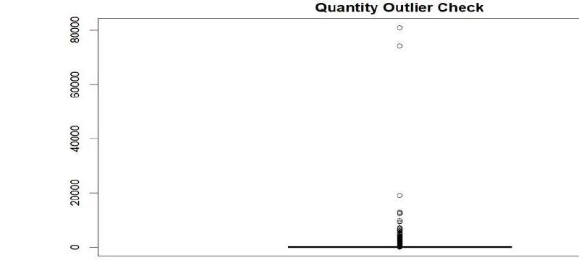
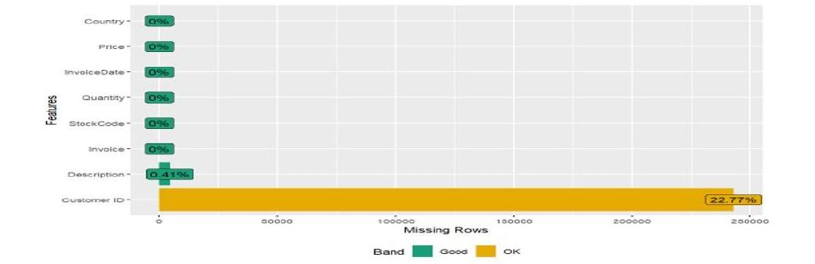
Data Preprocessing: Diagnostic Visualizations
Two diagnostic graphs generated during preprocessing, confirming the missing-value pattern and the presence of Quantity outliers.
Missing Value Diagnostic (plot_missing, Step 7.5)
Quantity Outlier Check (Step 7.13)
11

Slide 12
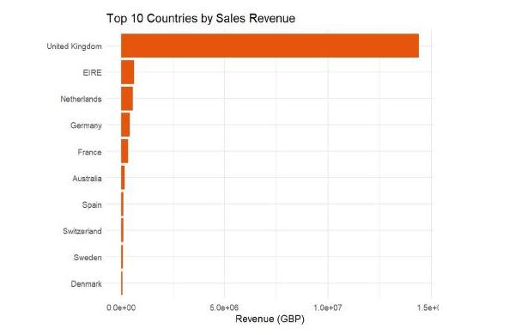
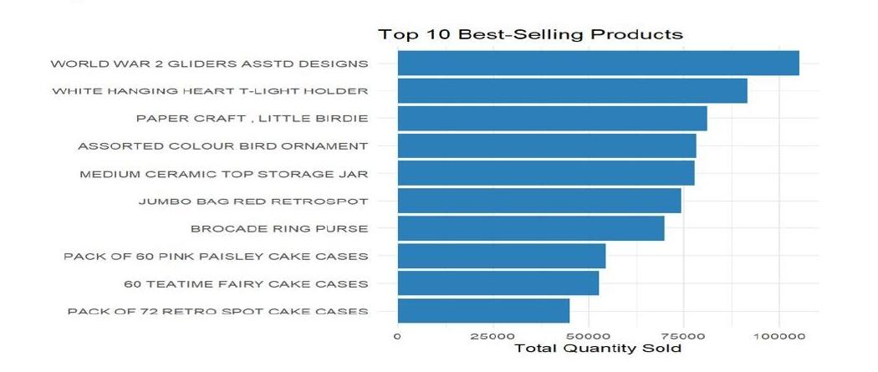
EDA: Product and Geographic Performance
R output generated from the cleaned dataset, illustrating product performance and geographic revenue distribution.
8.2 Top 10 Best-Selling Products
8.3 Top 10 Countries by Sales Revenue
12

Slide 13
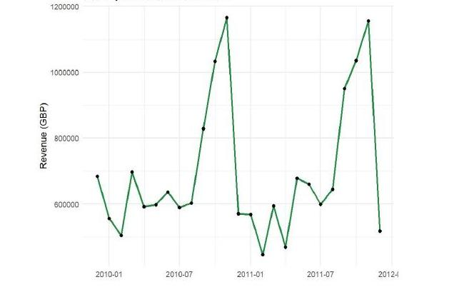
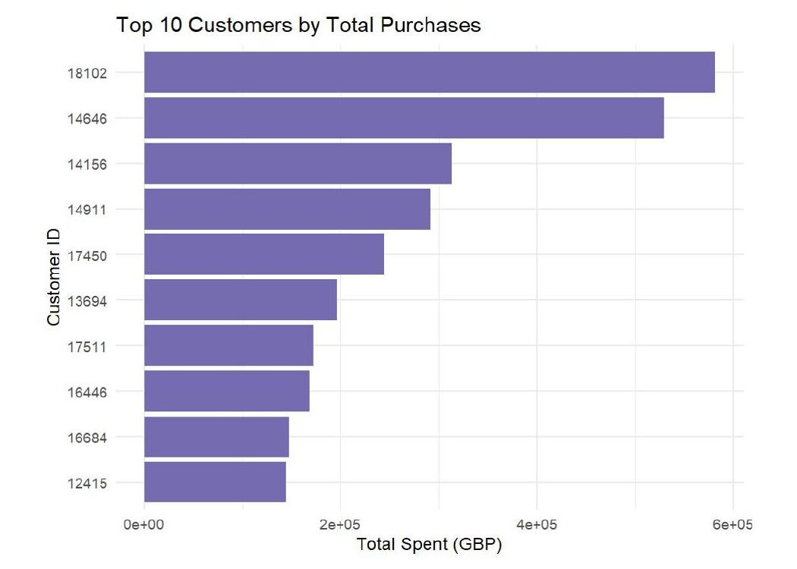
EDA: Revenue Trend and Customer Value
Revenue trend across the two-year period and the customers contributing the highest spend.
8.4 Monthly Sales Revenue Trend
8.9 Top 10 Customers by Total Purchases
13

Slide 14
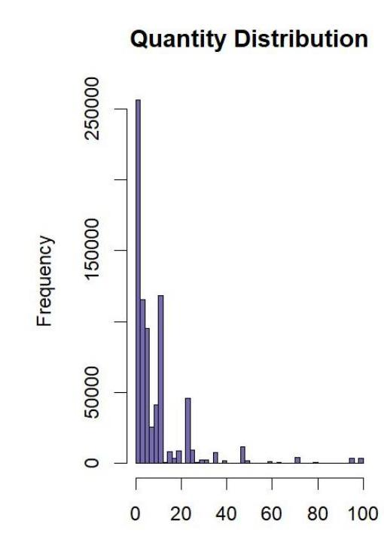
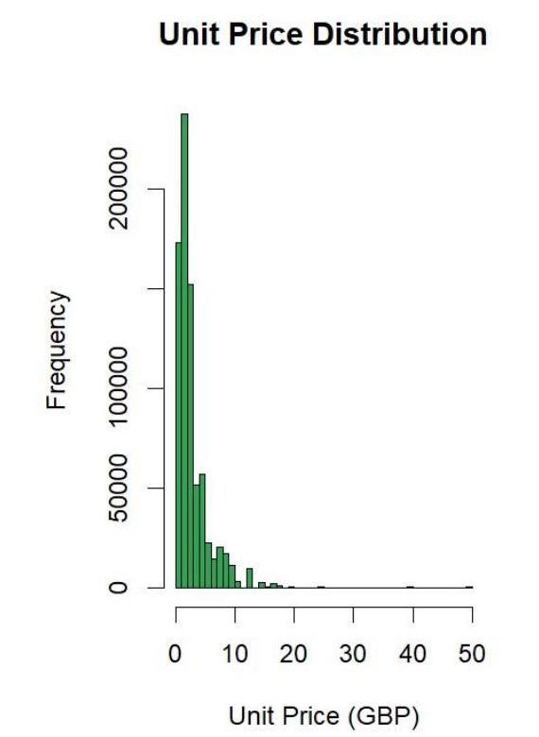
EDA: Quantity and Price Distributions
Histograms showing the typical number of units purchased per line and the typical product price point.
8.5 Quantity Distribution Histogram
8.6 Unit Price Distribution
14

Slide 15
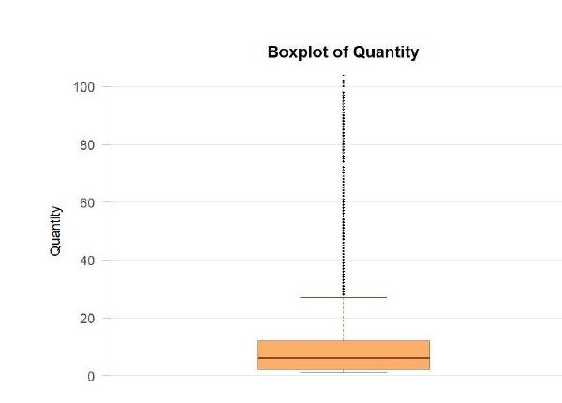
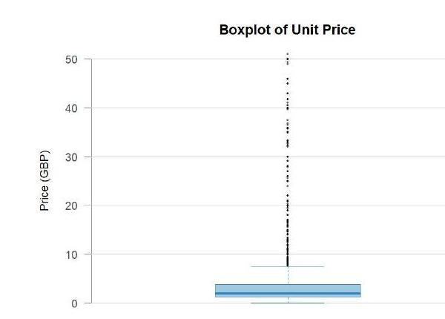
EDA: Spread and Outlier Structure
Boxplots visualizing the spread and outlier structure of the Quantity and Price fields.
8.7 Boxplot for Quantity
8.8 Boxplot for Unit Price
15

Slide 16
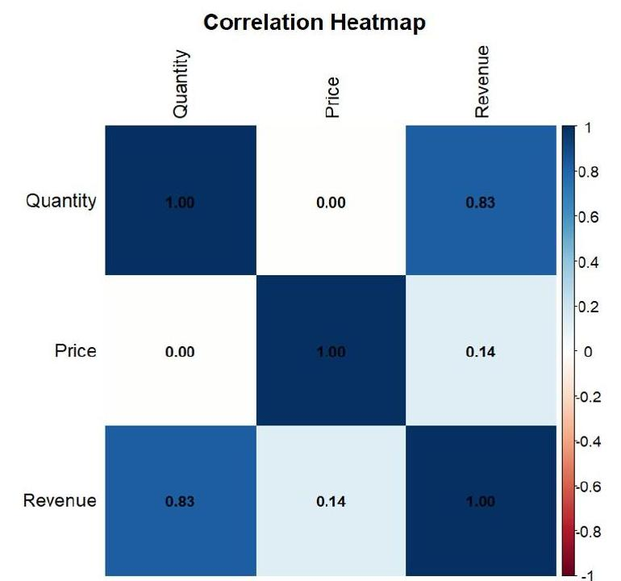
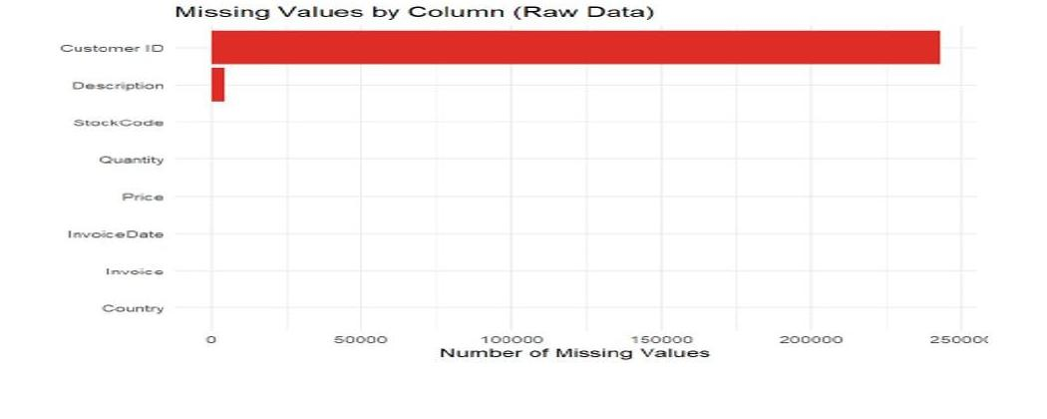
EDA: Data Quality and Feature Relationships
Verification of the missing-value pattern, and the relationship among Quantity, Price, and Revenue.
8.1 Missing Values by Column (Raw Data)
8.10 Correlation Heatmap (After Feature Engineering)
16

Slide 17
Conclusion
This project cleaned and explored nearly two years of e-commerce transaction data from the Online Retail II dataset, transforming an unrefined transactional export into a reliable, analysis-ready dataset. The dataset was selected for its scale, its authentic data-quality challenges, and the substantial body of published research already built around it, with five recent papers from IEEE, Springer, Elsevier, and MDPI reviewed to ground the overall approach in established methodology.
Fourteen preprocessing steps were carried out in R, reducing the raw dataset from 1,067,371 rows to 779,425 validated transactions. This included combining both source sheets, removing rows with missing Customer IDs, eliminating 26,479 duplicate records, separating cancelled orders and returns, correcting data types, and flagging 51,119 extreme Quantity values as outliers rather than discarding them, in recognition of this retailer's legitimate wholesale order patterns.
Ten exploratory visualizations were then built on the cleaned dataset, examining missing-value patterns, product performance, monthly revenue trends, country-wise sales, customer spending distribution, and the relationships between Quantity, Price, and Revenue. Together, these results confirm that the dataset is clean, well understood, and structurally ready for rigorous analysis - with the United Kingdom dominating sales, a small set of products and customers accounting for a disproportionate share of revenue, and clear seasonal peaks in the months preceding December.
17

Slide 18

Thank You
Questions and Discussion
Suyash Agrawaal | 24BDS1167 | Programming for Data Science (BCSE207L)
18

